Slide 1
Introduction to 'R'
Introduction to Statistics Course Week 1
February 10th – 21st 2014
Pwani University

Slide 2
Overview and History of R
R is a dialect of the S language.
S is a language that was developed by John Chambers and others at Bell Labs. S was initiated in 1976. (visit: http://stat.bell-labs.com/ or http://www.stat.bell-labs.com/S/history.html)
R was created in 1991 – by Rose Ihaka and Robert Gentleman
In 1993 R was released to the public. 1997: R core group was formed. 2000: R 1.0.0 was released
Currently we use R 3.0.2 : R version 3.0.2 (Frisbee Sailing) has been released on 2013-09-25
Notes:
Note on R Creation: Their experience developing R is documented in a 1996 JCGS paper.

Slide 3
Features of R
Runs on almost any standard computing platform/OS (even on the PlayStation 3)
Frequent releases (annual + bug_x releases); active development.
Useful for interactive work, but contains a powerful programming language for developing new tools (user --> programmer)

Slide 4
Features of R cont.
Very active and vibrant user community; R-help and R-devel mailing lists and Stack Overflow – look at them on when at R help
It's free! (Both in the sense of beer and in the sense of speech.)

Slide 5
Setup Environment
Installing R and R Studio
We use this document
R-studio?
RStudio is the premier integrated development environment for R.
Why R-studio?
RStudio's source editor includes a variety of productivity enhancing features including syntax highlighting, code completion, multiple-file editing, and find/replace, retrieving prev commands
Notes:
Installing: The r system for statistical computing consists of two major parts: the base system and a collection of user contributed add on packages. A package is a collection of functions, examples and documentation.
R Studio: RStudio is the premier integrated development environment for R. It is available in open source and commercial editions and runs on the desktop (Windows, Mac, and Linux) or over the web with RStudio Server.

Slide 6
Help Areas
R Help Mailing List - https://stat.ethz.ch/mailman/listinfo/r-help
R Commander - http://socserv.mcmaster.ca/jfox/Misc/Rcmdr/
Quick R - http://www.statmethods.net/
R CookBook - http://www.cookbook-r.com/
R-Bloggers - http://www.r-bloggers.com/
Inside R- http://www.inside-r.org/blogs
Try R - http://tryr.codeschool.com/
Video Tutorials - http://www.twotorials.com/
Stack overflow About R - http://stackoverflow.com/tags/r/info
Stack overflow R FAQ - http://stackoverflow.com/tags/r
R google group - https://groups.google.com/forum/#!forum/r-help-archive

Slide 7
The Terms
Object R is an object oriented language and everything in R is an object.
We store using <- or = operator ie x <- 3 | x=3
Vector A collection of one or more objects of the same type . We use c() or vector()
Function A set of instructions carried out on one or more objects.
function mean() is used to calculate the arithmetic mean
Operator Is a symbol that has a pre-defined meaning. +*-/
Parameter The kind of information that can be passed to a function – mean(age)
Notes:
5 of them

Slide 8
Packages
A set of functions designed to perform more specific statistical or graphical tasks examples and documentation.
4000+ packages found on the CRAN
To use packages in R, we must first install them using the install.packages()
Notes:
Comprehensive R Archive Network (CRAN)

Slide 9
Data Types (Class)
Character i.e. names
Numeric (real numbers) i.e. 4.56788
Vector
Factor
Logical i.e. True False
Notes:
Classes of r

Slide 10
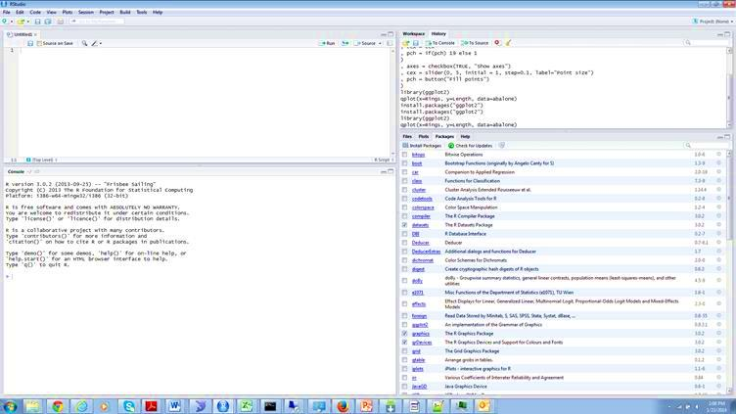
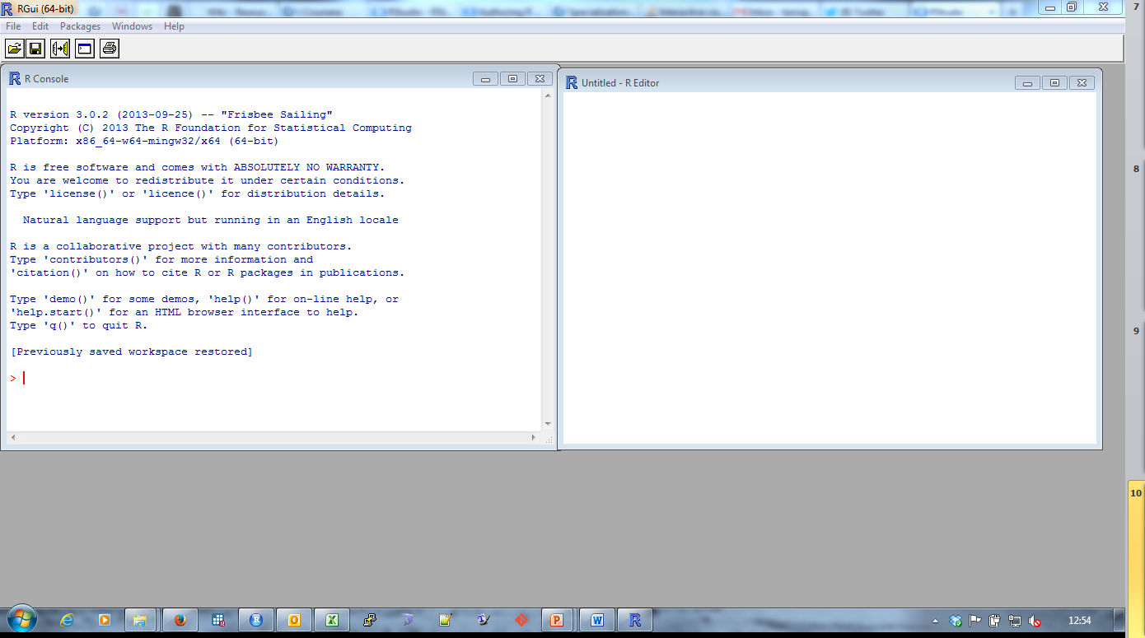

Slide 11
Vector
A vector can only contain objects of the same class
a <- c(1,2,5.3,6,-2,4) # numeric vector
b <- c("one","two","three") # character vector
c <- c(TRUE,TRUE,TRUE,FALSE,TRUE,FALSE) #logical vector

Slide 12
Matrices
All columns in a matrix must have the same class(numeric, character, etc.) and the same length. The general format is
mymatrix <- matrix(vector, nrow=r, ncol=c, byrow=FALSE, dimnames=list(char_vector_rownames, char_vector_colnames))
byrow=TRUE indicates that the matrix should be filled by rows

Slide 13
Factors
Used to represent categorical data.
Can be unordered or ordered.
A factor is like an integer vector where each integer has a label.
x <- factor(c("yes", "yes", "no", "yes", "no"))

Slide 14
Missing values
Missing values are represented by the symbol NA (not available)
Impossible values (e.g., dividing by zero) are represented by the symbol NaN (not a number)
is.na(x) # returns TRUE of x is missing
mean(x, na.rm=TRUE) # exclude missing in functions
complete.cases() #returns the number of complete cases
Notes:
# list rows of data that have missing values mydata[!complete.cases(mydata),]

Slide 15
Data Frames
More general than a matrix,
has different columns and can have different modes (numeric, character, factor, etc.)
Used to store tabular data
Can store data of different classes
read.table() or read.csv() – used to load dataframes

Slide 16
Create Data Frames
data.frame(foo = 1:4, bar = c(T, T, F, F))
x <- (1,2,3,4,5,6,7,8,9)
y <- c(a,b,c,d,e,f,g,h,i)
df <- data.frame(x=x, y=y)
print(df)

Slide 17
Datasets
R works with datasets as textfiles
Base R functions read.table and read.csv can read in data stored as text files, delimited by almost anything
Data from other stat packages can be read using
read.xlsx(file, sheetIndex=1) #excel files
read.dta(file)# stata files

Slide 18
.RDA Data
R Data type
Can be created from other data sets
data <- load("profit.rda")
Saving a data frame as an rda
Save(data.frame, “dataset.rda”)

Slide 19
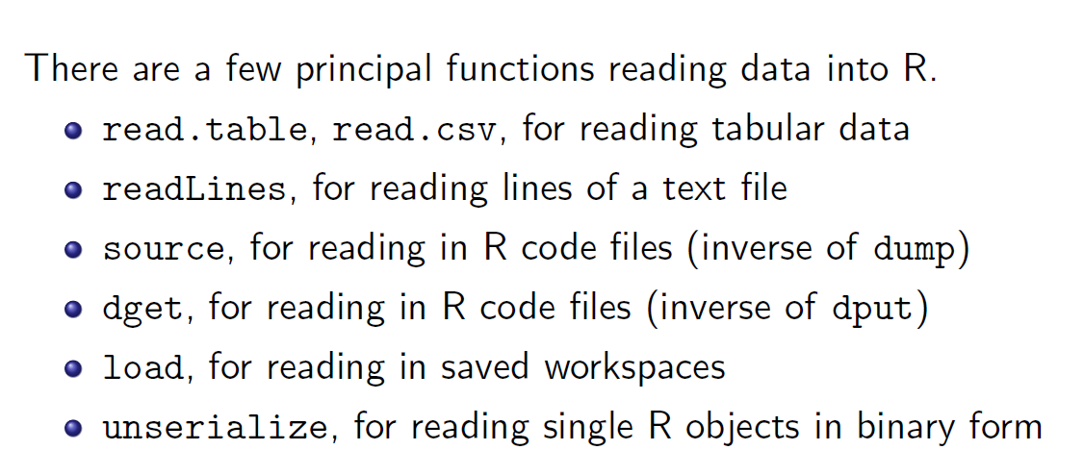
Reading Data Sets
Source: Computing for Data Analysis
Roger Peng

